Slide 1

SII1500
SEPTEMBER INNOVATION INVITATIONAL
1500

Slide 2
Congratulations on your learning journey…
Amazon Web Service - Sandboxes
Amazon SageMaker
Amazon CloudWatch Logs
Machine Learning – reinforcement
Machine Learning – training
Machine Learning – hyperparameters
Python Programming

Slide 3
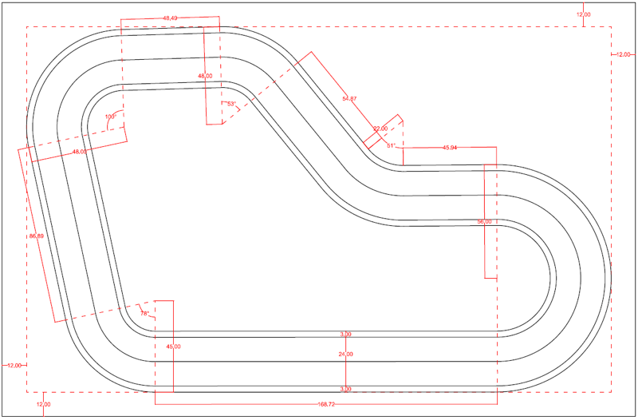
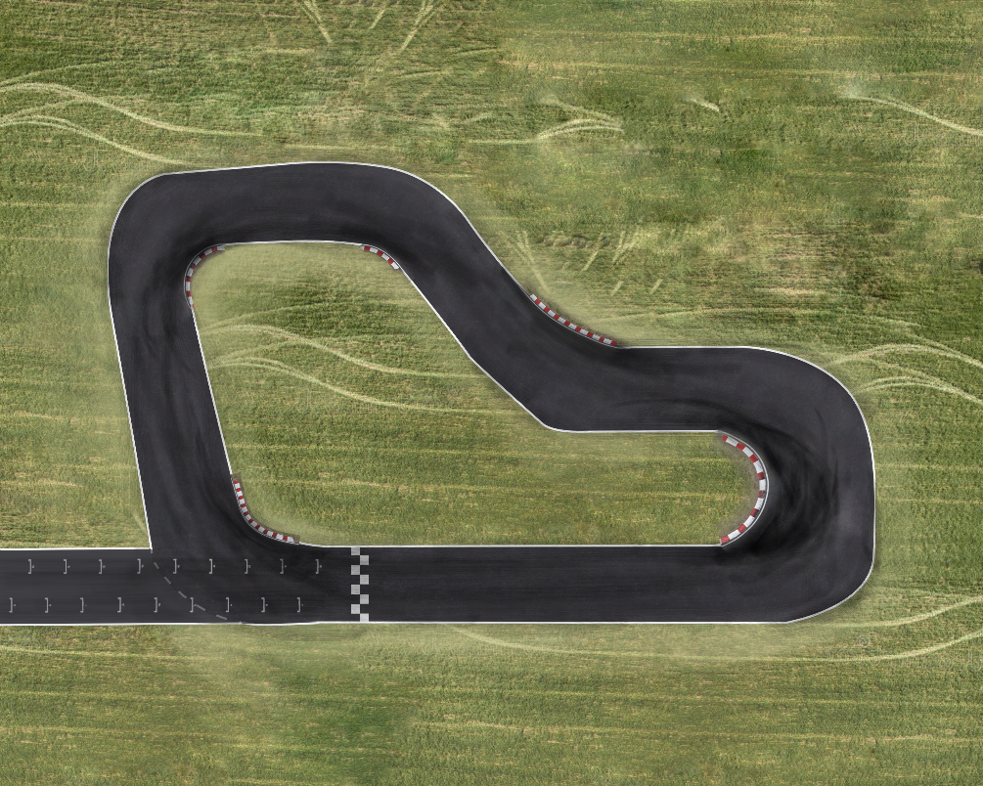
Race Notes
Car position and performance, lap times and on-track/off-track judgement taken directly from model evaluation AWS Cloudwatch logs.
Model performance is preserved in the race outcomes.
Race renderings have a degree of artistic licence.
Track was narrowed from JII500
Initial offset introduced for the starting grid
These do not affect the race outcomes.

Slide 4
TEAM INTROS

Slide 5
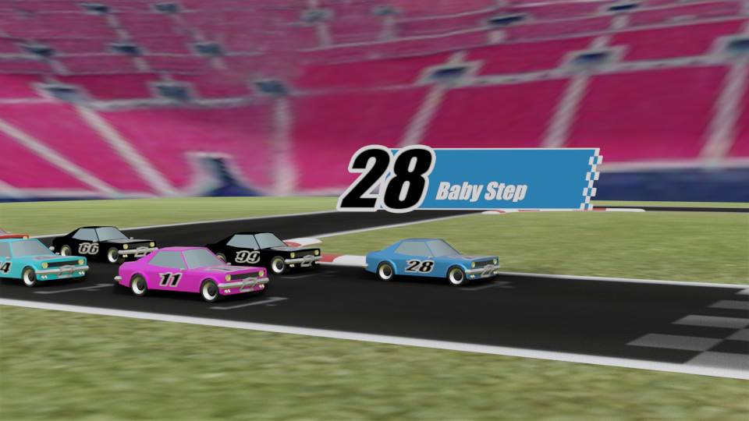
#28: BabyStep
Members: Naresh, Suren
Model: BS01-0917-NE-3-6
July Race Result: 12th Place, 2019 Champions

Slide 6
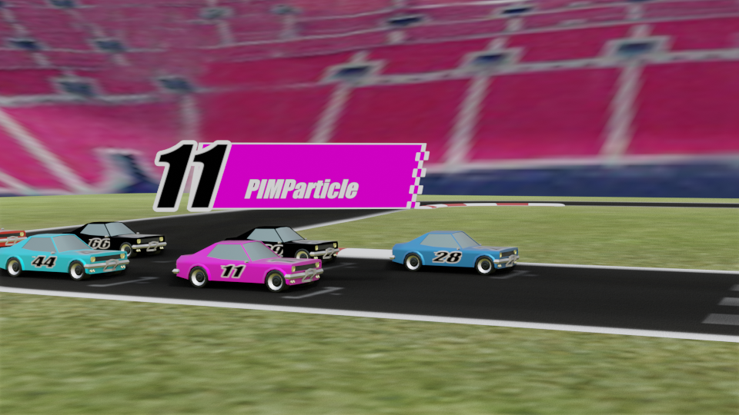
#11: PIM Particle
Members: Brooke, Jim, Robert, Olana
Model: PIMParticle-Brooke-003v12
July Race Result: 6th Place

Slide 7
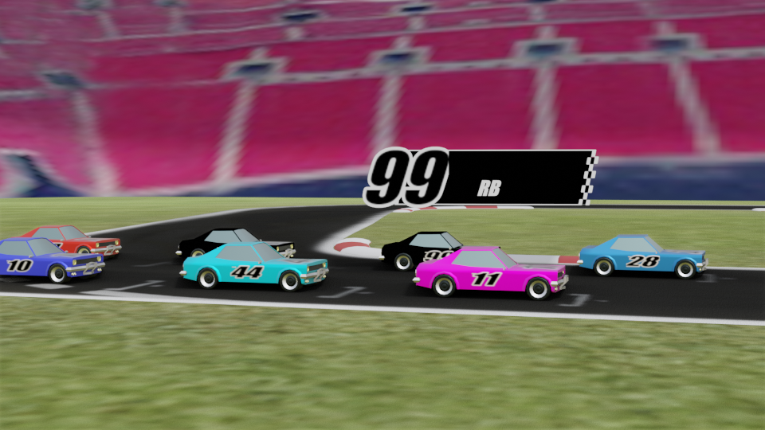
#99: RB
Members: Robert, Jeff, Jean, Linda
Model: RB-0002-T20-NAS-T0
July Race Result: 2nd Place

Slide 8
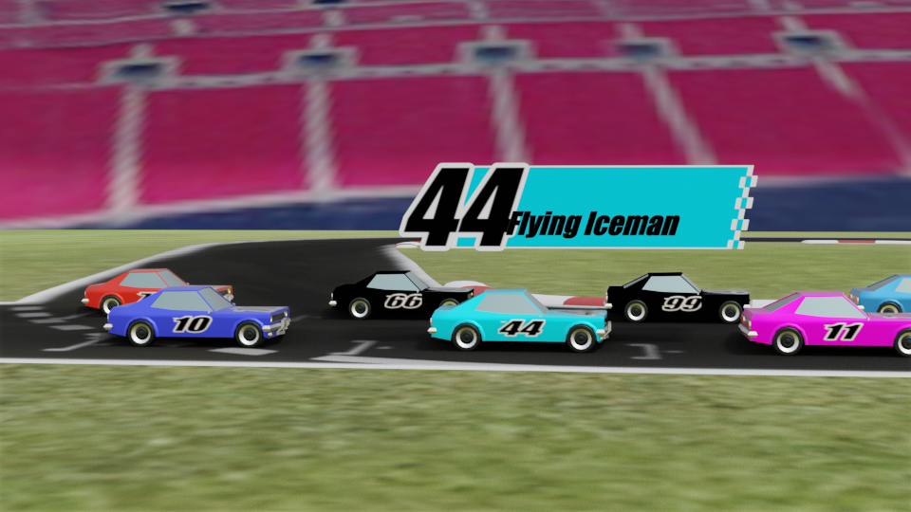
#44: Flying Iceman
Members: Neeraj, Avinash, Dorairaj
Model: HammerTime-24-2-V2-clone
July Race Result: N/A

Slide 9
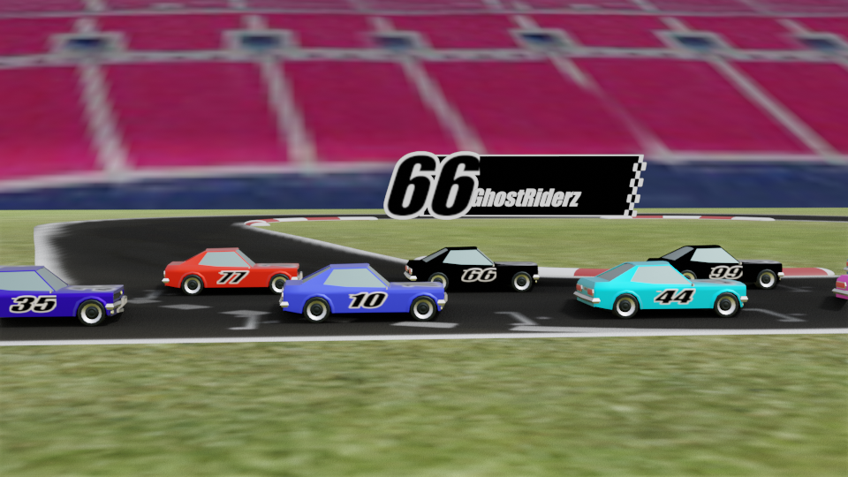
#66: GhostRiderz
Members: Huyen, Vaibhav, Hetal
Model: GhostRiderz-Vaibhav-300V2
July Race Result: 4th Place

Slide 10
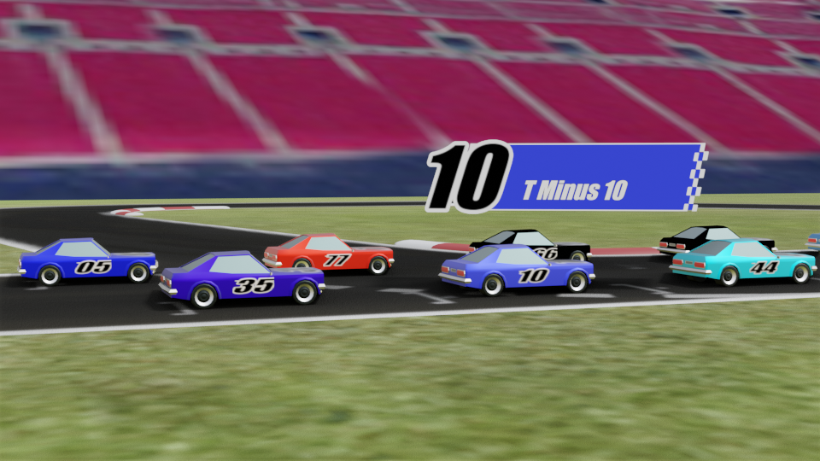
#10: T Minus 10
Members: Pathi, Sashi, Sudheer, Hema
Model: TM10-918-S4-T3
July Race Result: 7th Place

Slide 11
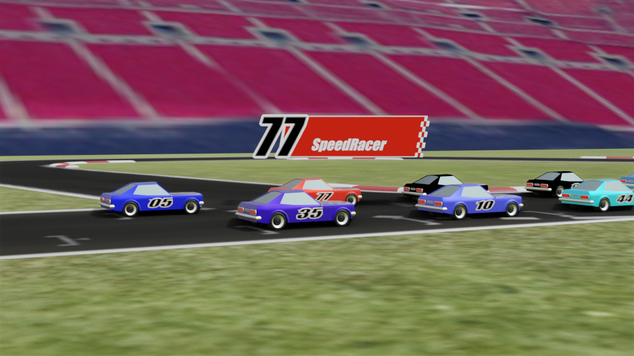
#77: SpeedRacer
Members: Richard, Prathamesh, Gigetta, Daniel
Model: SpeedRacer-SK-016v13
July Race Result: 1st Place

Slide 12
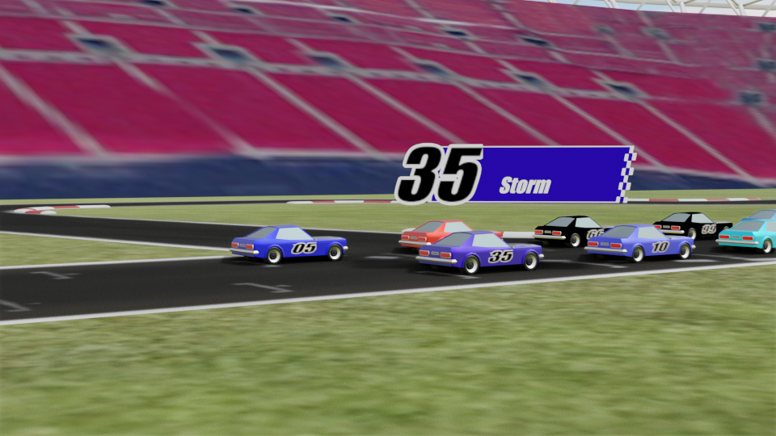
#35: Storm
Members: Renee, Hal, Haya
Model: Storm-RCORG-72S-clone
July Race Result: 10th Place

Slide 13
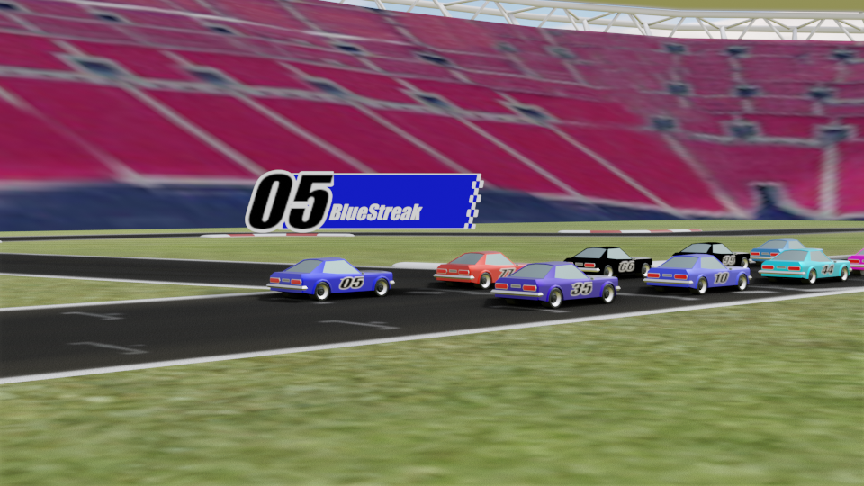
#05: Blue Streak
Members: Surendar, Marc, Bruce, Chris, Ashutosh
Model: BlueStreak-Chris-101-training5
July Race Result: 3rd Place

Slide 14
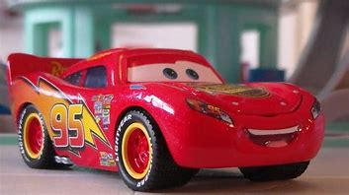
#95: Lightning McQueen
Members: Edwin, Rami, Osniel, Beauclair
Model: LightningMcQueen-Model11-clone
July Race Result: 11th Place

Slide 15
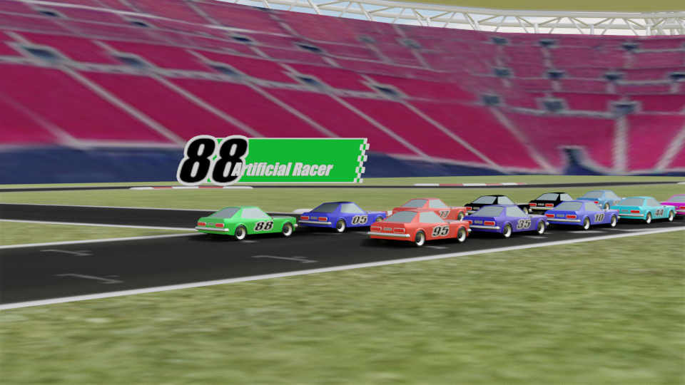
#88: Artificial Racer
Members: Courtney, George, Aditya
Model: ArtificialRacers-S3p2T26D-5b
July Race Result: 5th Place

Slide 16

Let’s go racing!
Thanks for taking part and good luck to everyone!
This Photo by Unknown Author is licensed under CC BY-SA

